Slide 1
Api reference
https://kubernetes.io/docs/reference/generated/kubernetes-api/v1.21/

Slide 2
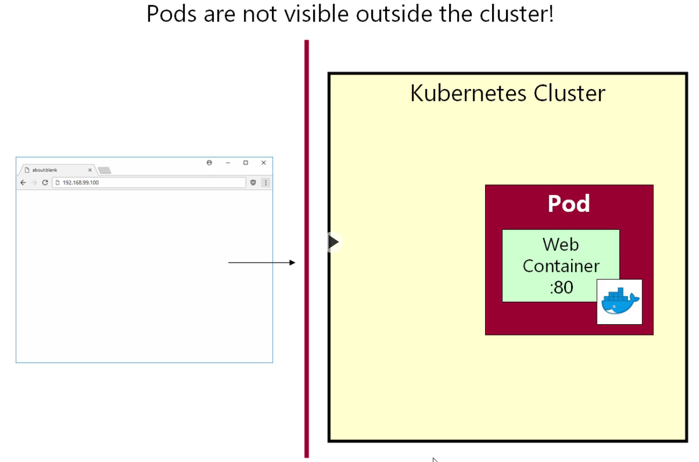

Slide 3
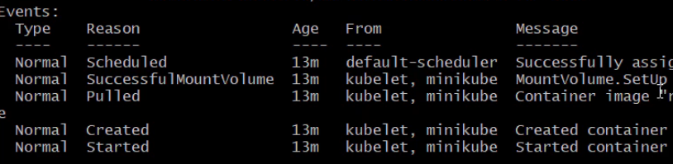
Describe pods
Kubectl describe po <pod-name>
In case of any issue with the pods, we can check out the emitter events

Slide 4
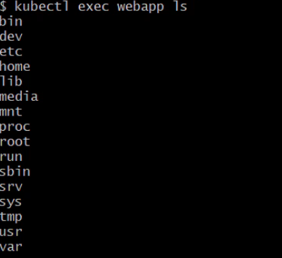
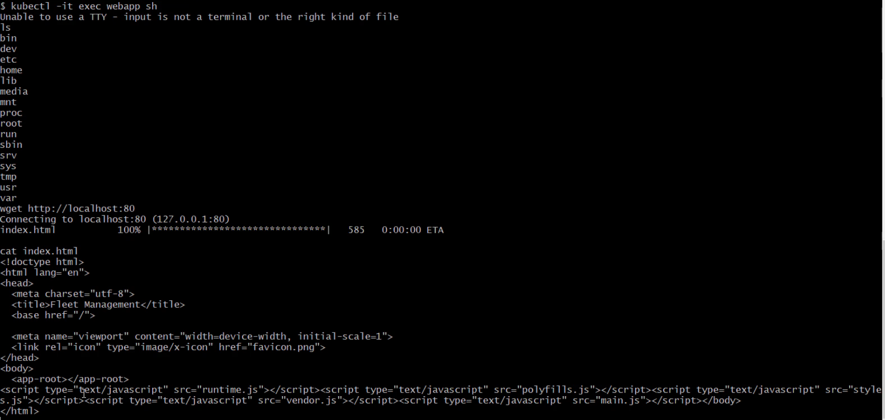
Kubectl exec <pod-name> <unix command>

Slide 5
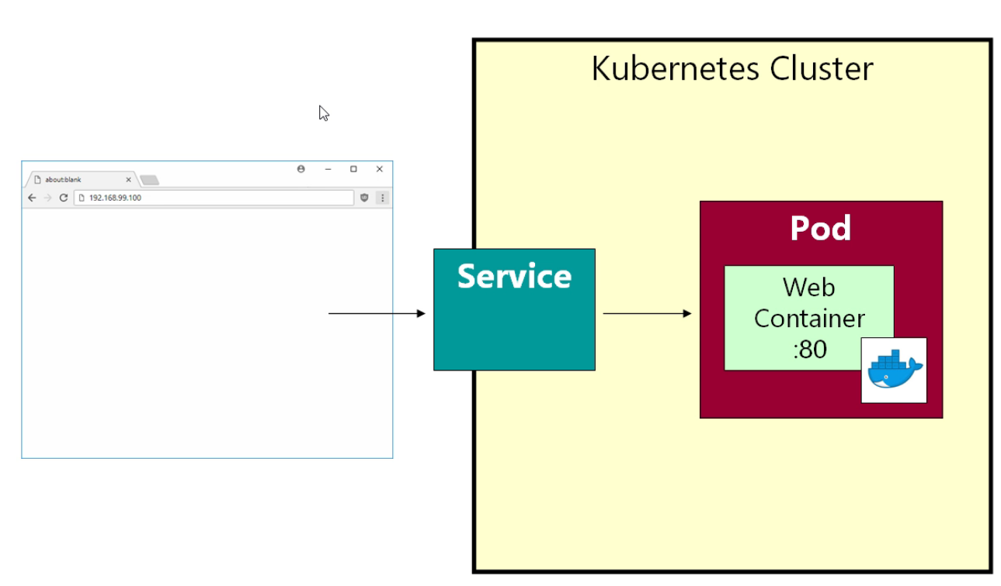
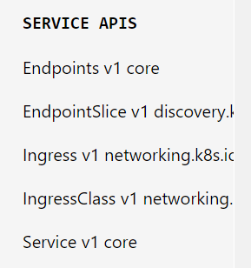
Service
Pods have very short lived lifecycle. They are like phoenixes, Die, take birth again and again die.
Services have much longer lifecycles
They will have ip addresses and stable fixed pods . Outside worlds interacts with our pods via services

Slide 6
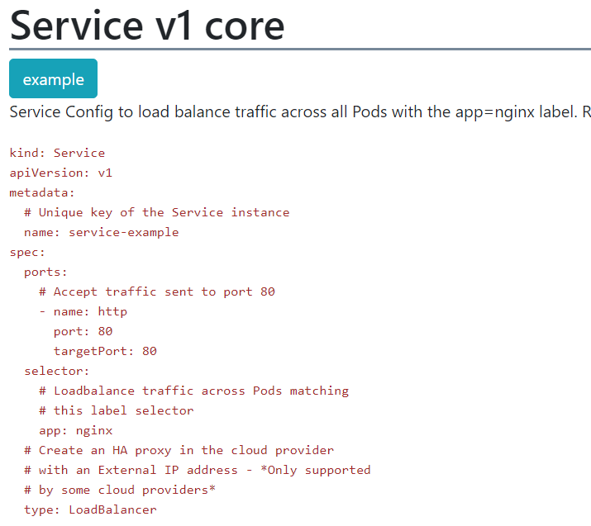
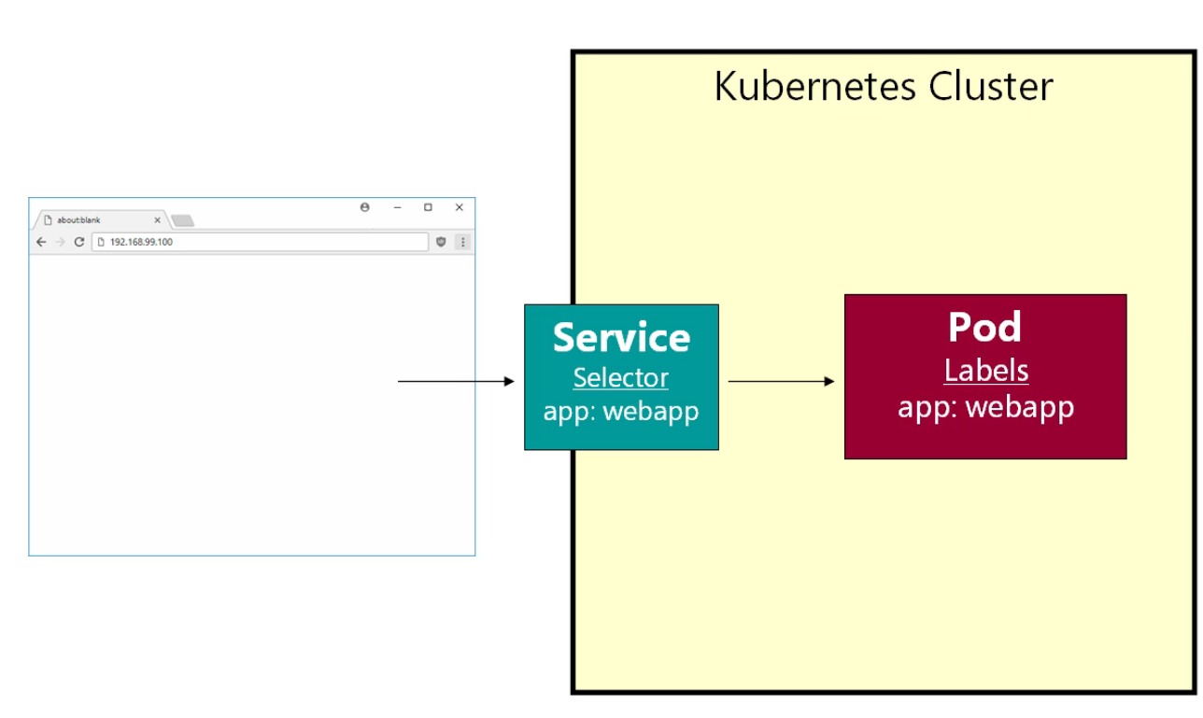
Label / Selector
Labels and selectors can be anything, absolutely anything.
We give a label to a pod and a selector to a service
Services talk to each other using a service name

Slide 7
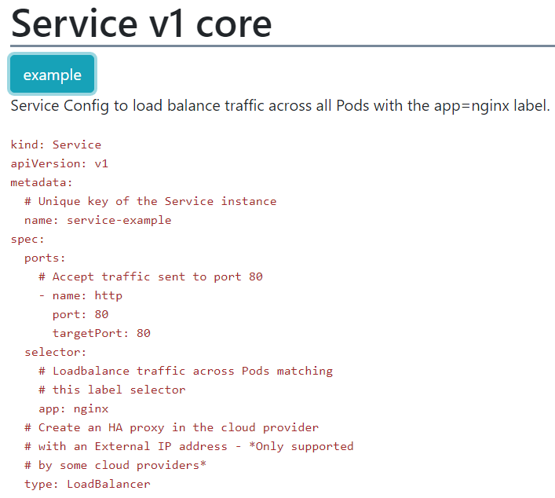
Service →
Service Name is used by pods to interact with each other
Port is the port at which the request comes in
Target port is the port at which your pod runs. Emulates the docker –p(publish command) at a port.
Type: loadBalancer works in a cloud environment. If not specified we use Cluster IP or Node IP

Slide 8
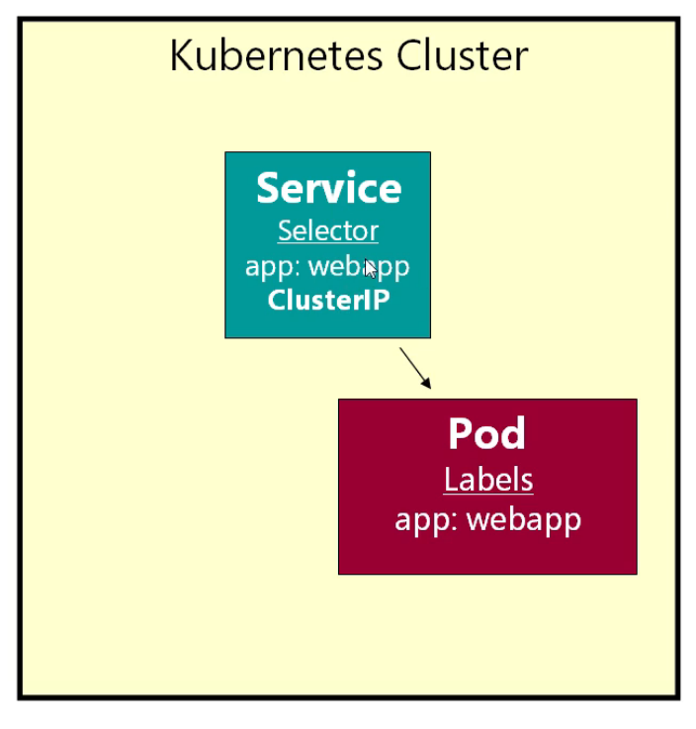
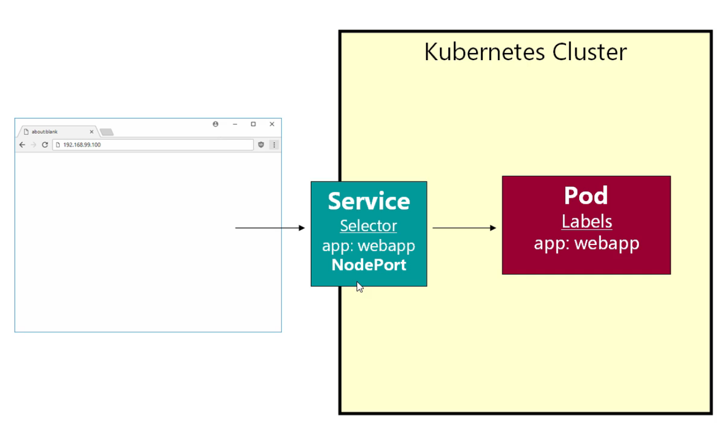
Cluster IP (Private) vs Node Port (Public)

Slide 9
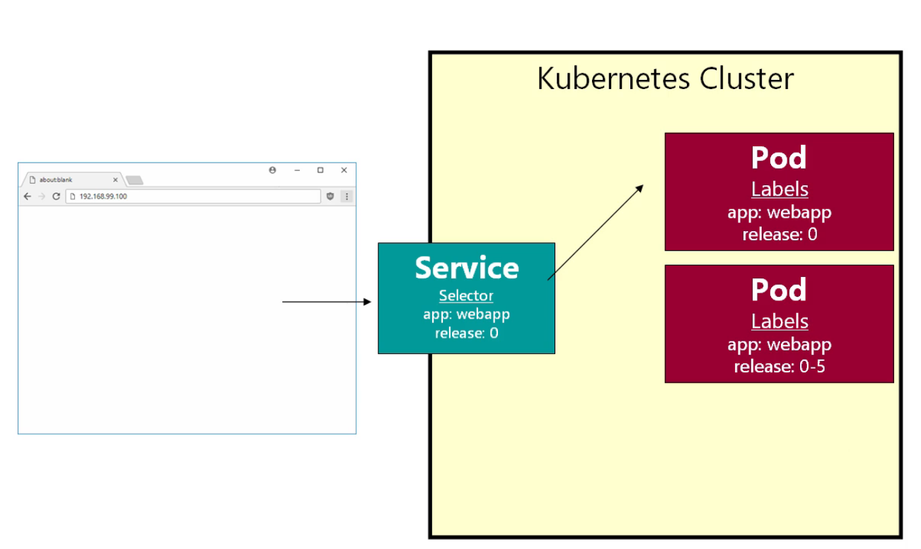
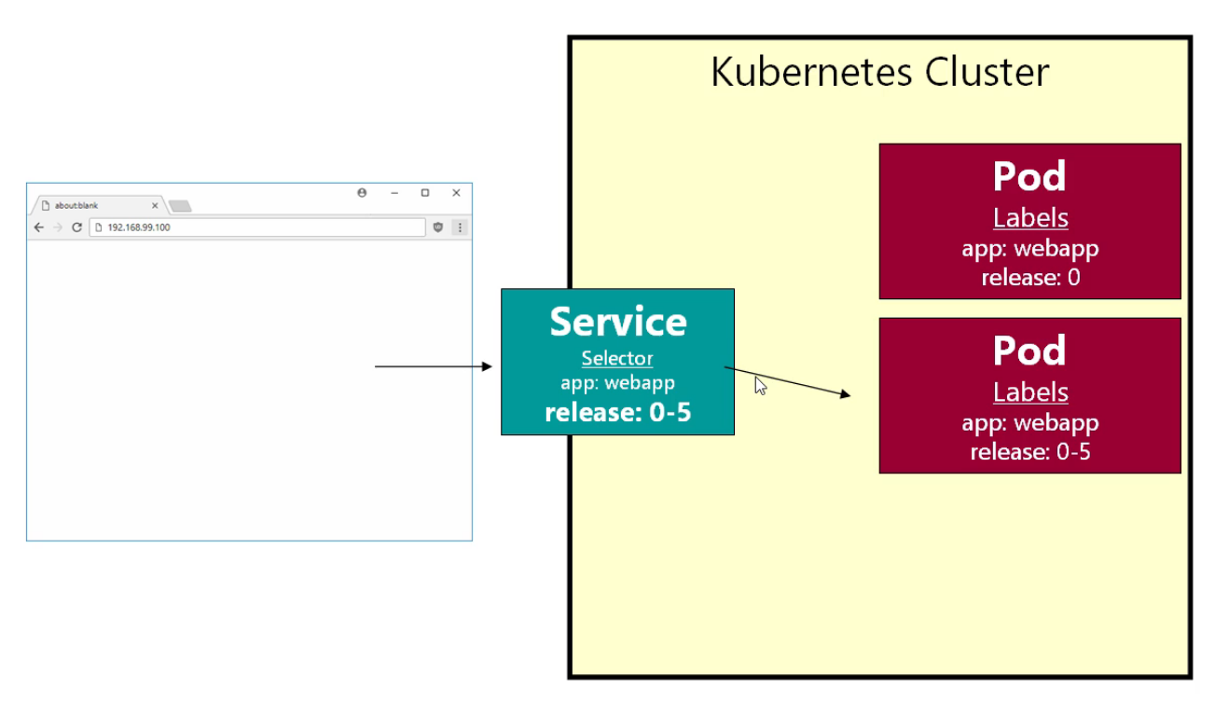
Very Naive rolling Deployment using labels
Can use –l filters to further filter our pods

Slide 10
Replica Sets
Pods can die because of many reasons.
High Resource Usage
Node down time
Etc…
If a Pod dies it won’t come up automatically unless it is deployed inside a replica set

Slide 11
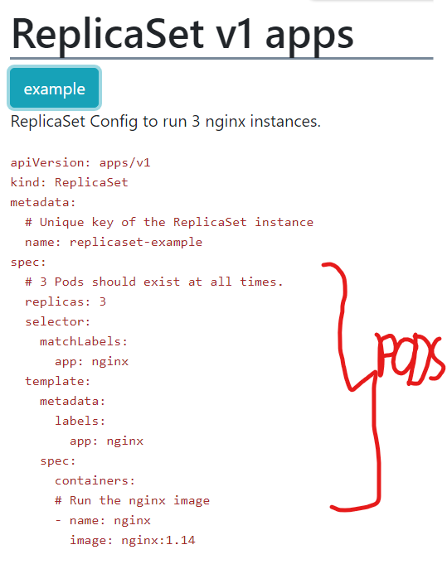
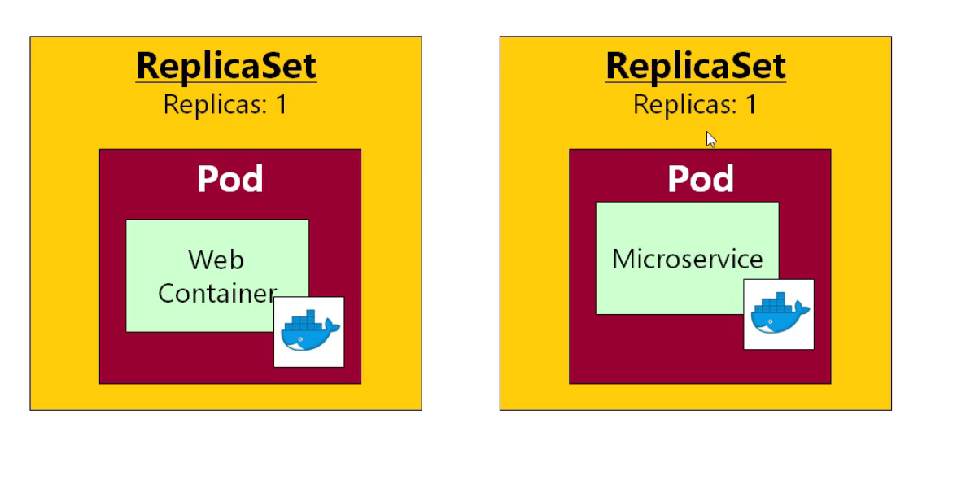
Replica Set is just an additional configuration which we give to Kubernetes which tells us that at a given point how many pods of a specific type are running.

Slide 12
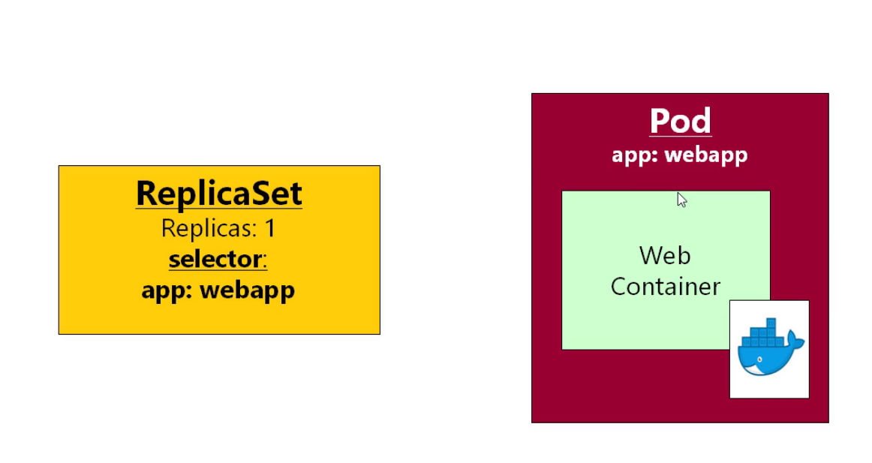
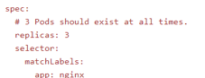
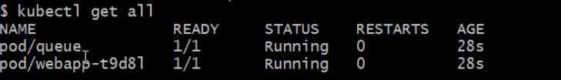
Stitching Replica Sets and Pods

Slide 13
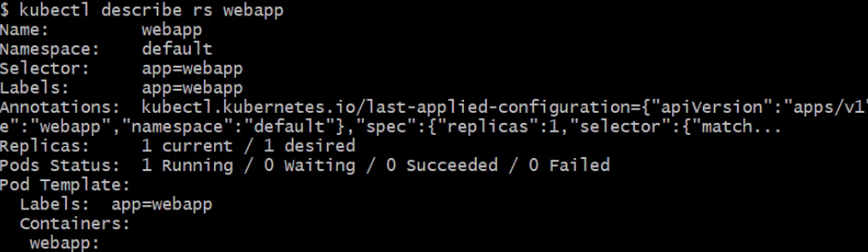
Above shows how the replica sets trigger the pods
Whenever the pod crashes or if you delete the pods, the Kubernetes because it is managing the pods through the replica sets, it would restart the pods on its own.

Slide 14
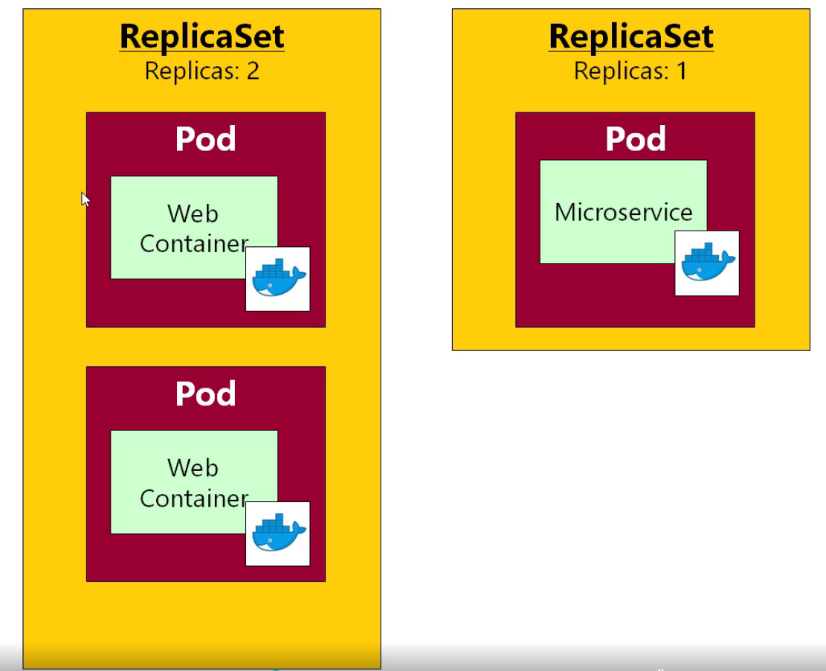
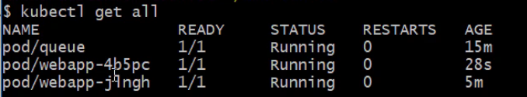
Keep replicas >1 like replicas = 2

Slide 15
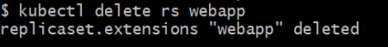
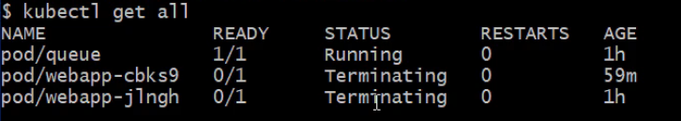
Delete Replica sets (Cascading Delete)

Slide 16
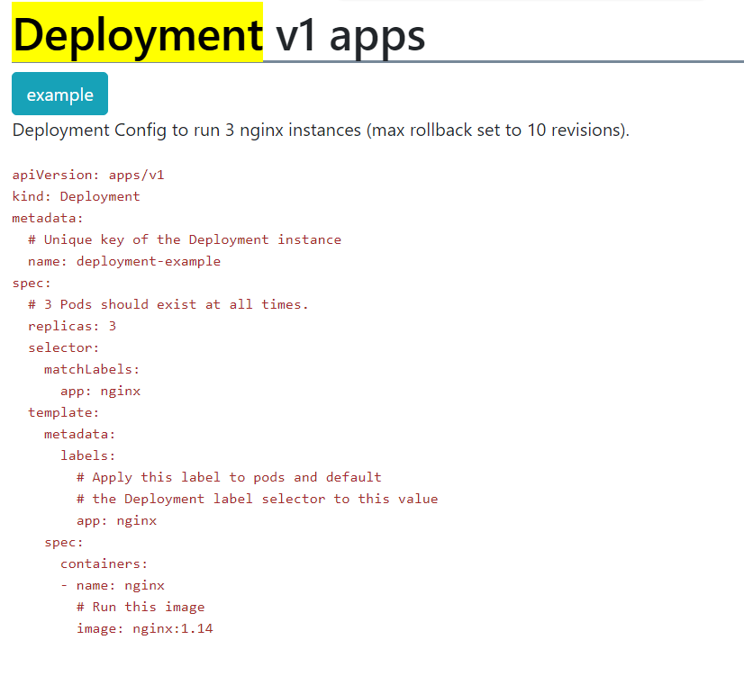
Deployments
This encapsulates replica sets
Has some advantages like
rolling Deployments etc.

Slide 17
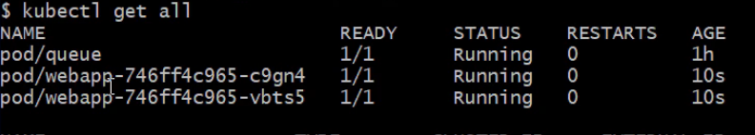
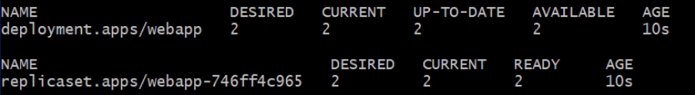
Deployments continues
When we create the deployments, it also automatically creates the replica sets.
Note the name of the replica sets and then how the pod names extend the replica sets.

Slide 18
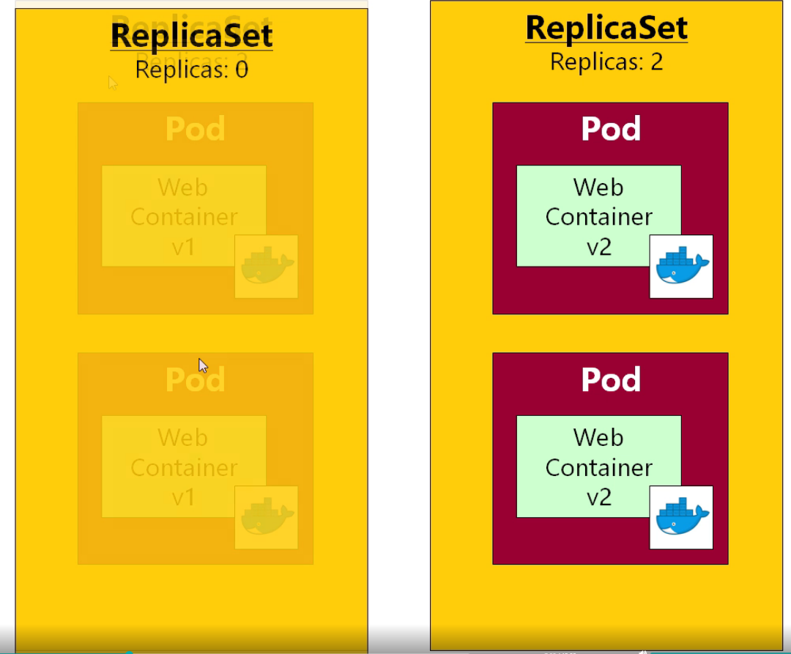
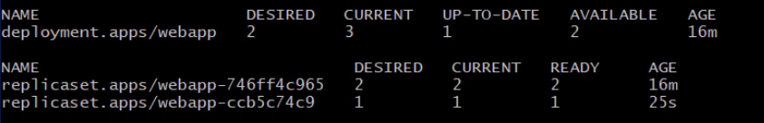
Rolling Deployments
So when we deploy the deployments, what is basically happening is that the number of replicas is going to zero.
If the deployments fails, we can rollback to the old replica set by setting the replicas of the old replica set to be non zero.

Slide 19
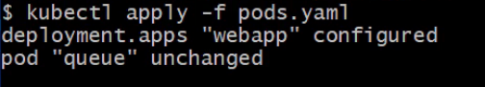
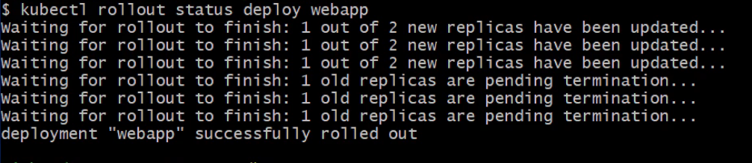
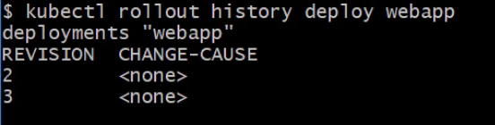
Managing Rollouts

Slide 20
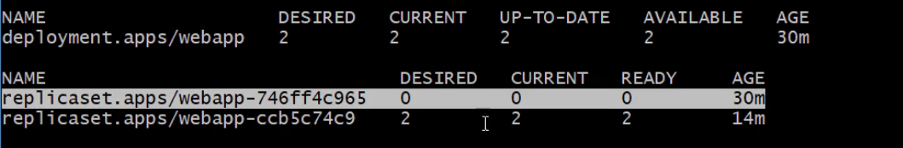
Auto Rollouts
Kubernetes remembers the last 10 replica sets.
It just reverts back to the old replica set seamelessley.
Note that the k8s does not match the yaml documents, so just a super admin sort of a feature

Slide 21
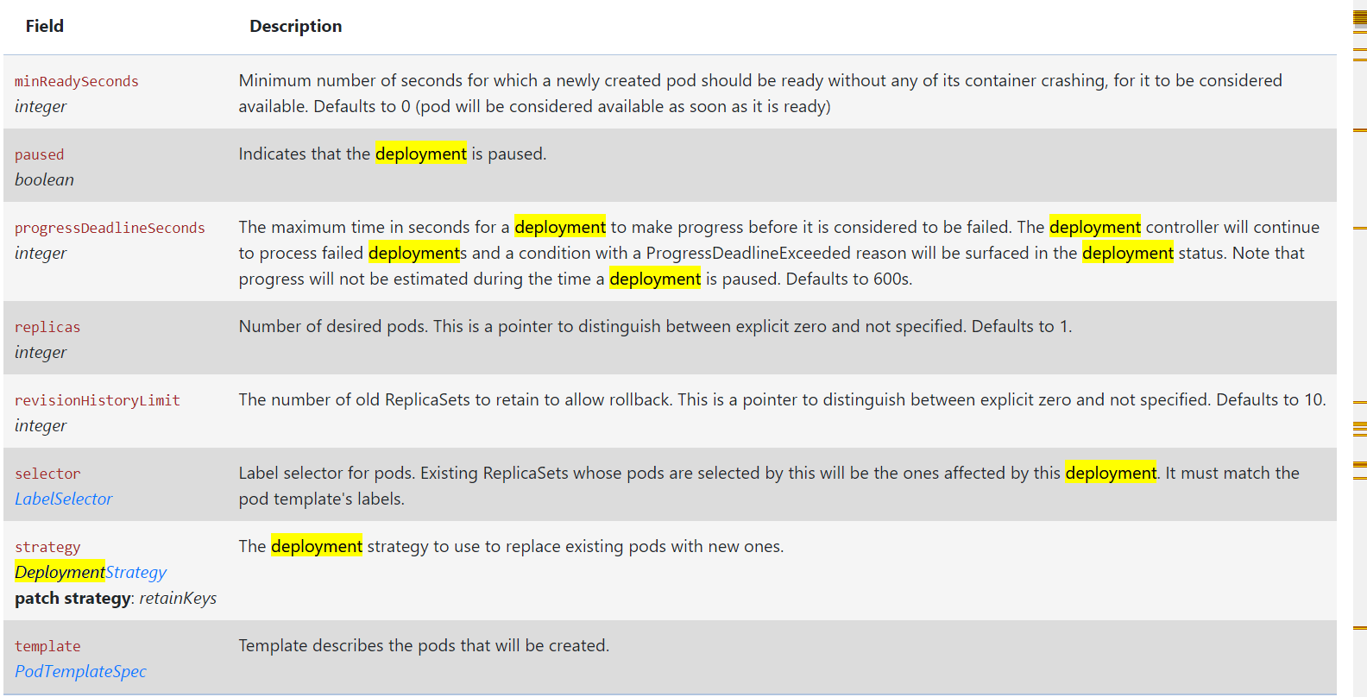
Deployments has some smart parameters

Slide 22
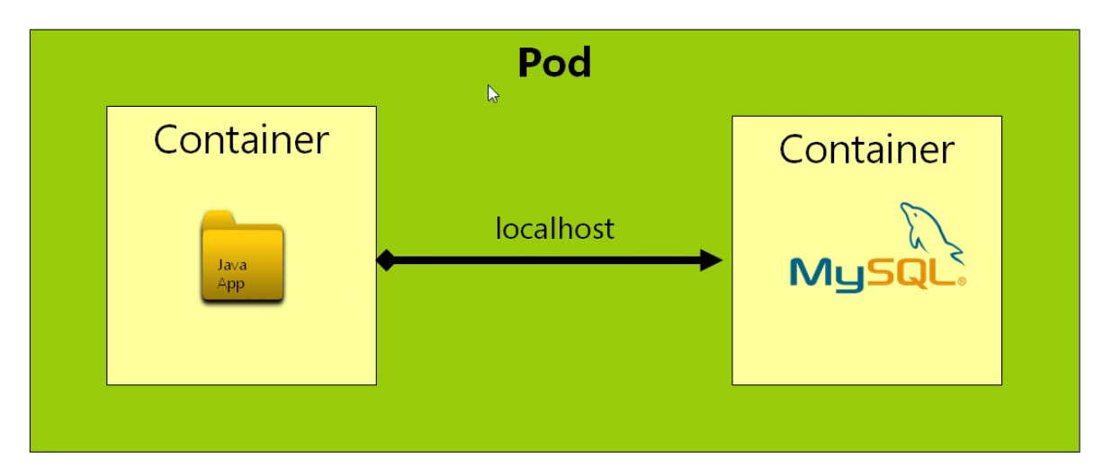
Service Discovery
Side cars can access each other using localhost

Slide 23
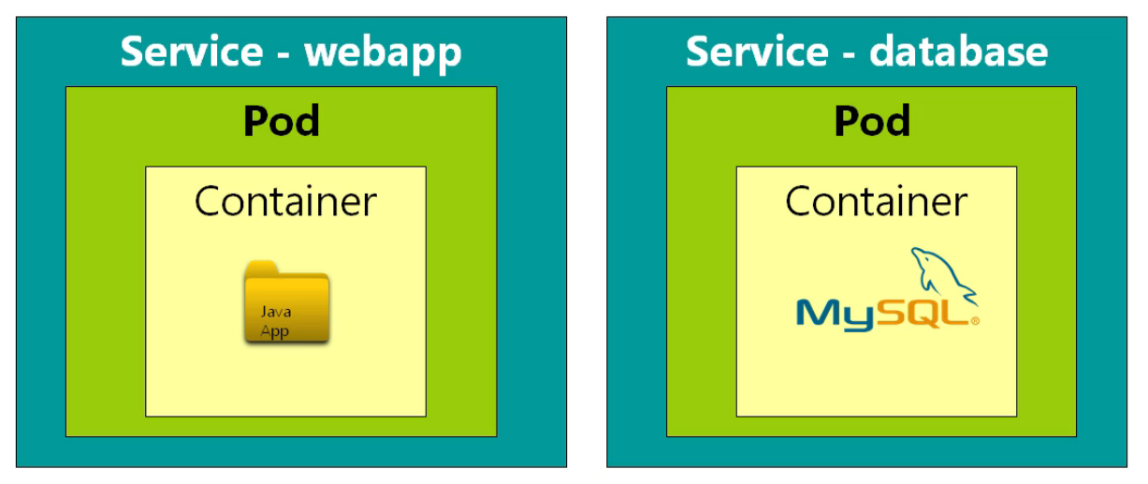
Ideal Scenario

Slide 24
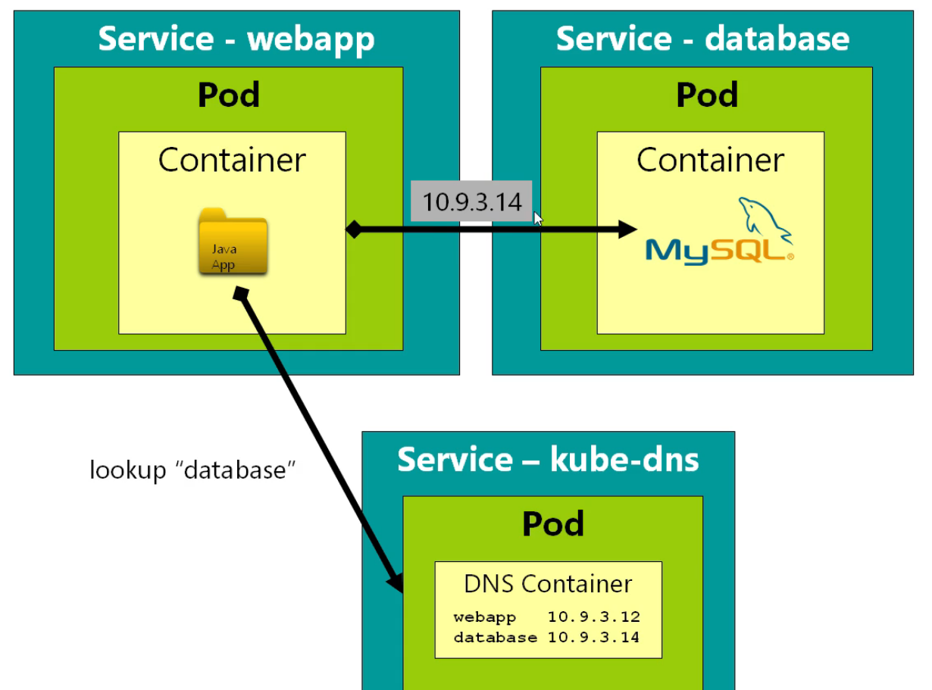
Networking

Slide 25
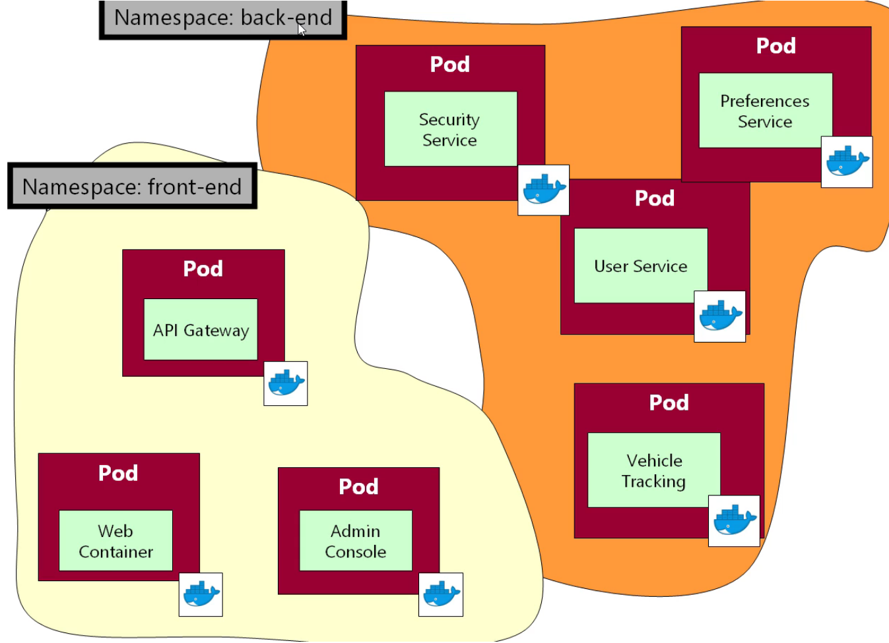
Namespaces

Slide 26
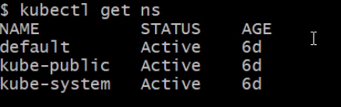
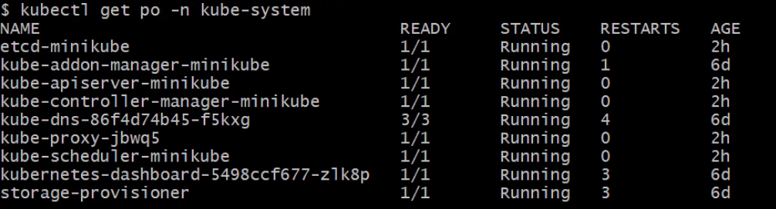
In any command if we don’t specify a namespace it defaults to a default namespace.
Kubernetes comes with some defalt namespaces like
Specific details for a specific namespace

Slide 27
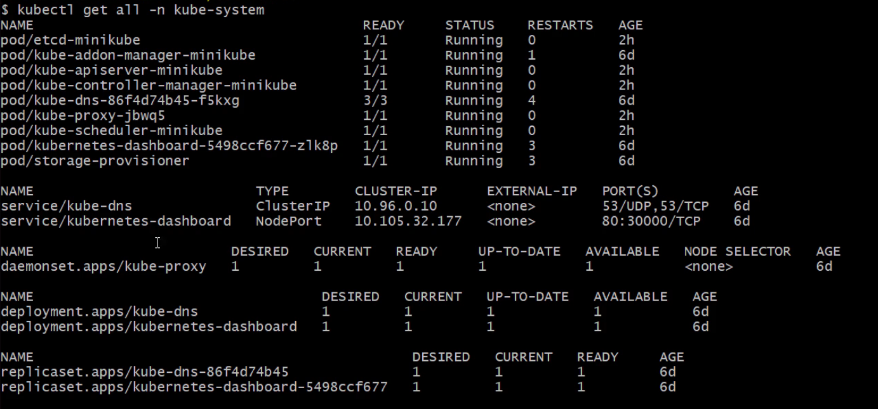
Kubectl get all

Slide 28
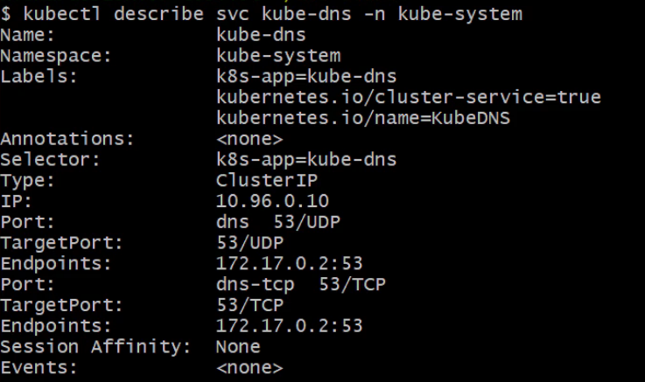
Let’s investigate DNS

Slide 29
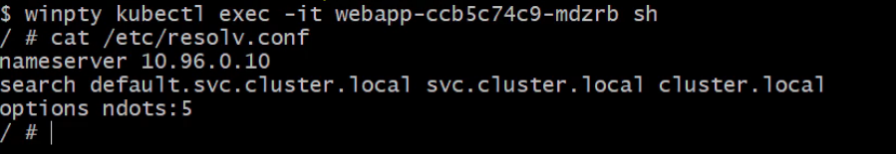
Auto Wiring
When Kubernetes starts an pods it injects the file resolv.conf which handles the dns resolution to the pods. This file handles the dns name resolution.

Slide 30
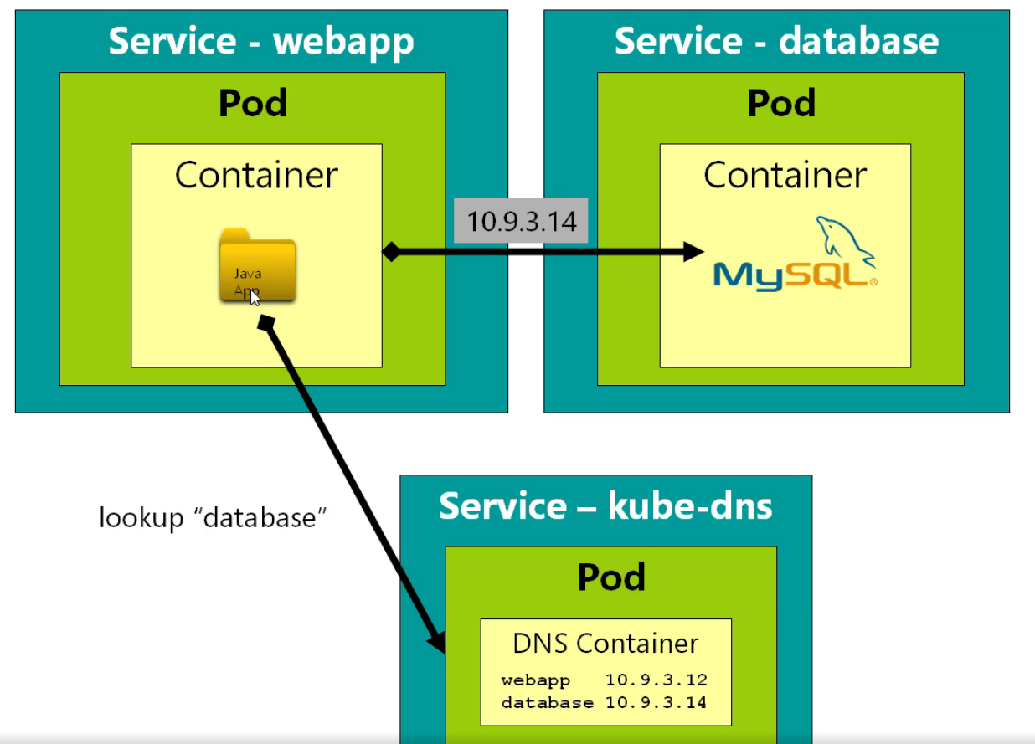

Slide 31
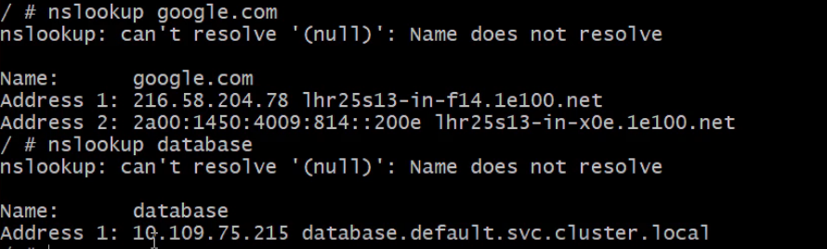
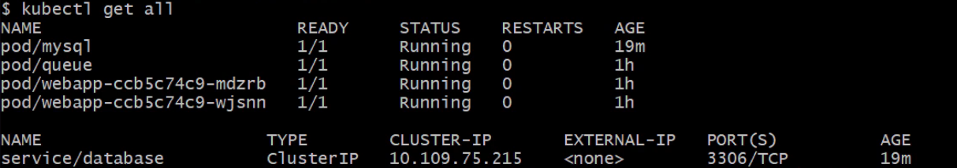
DNS Resolution from name to the service name

Slide 32
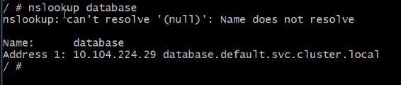
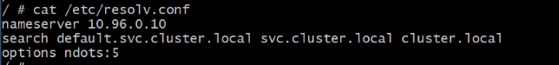
FQDN (Fully Qualified Domain Name)
Services are registered as services.namespace.svc.local
Note how the the dns is configured in the resolv.conf, which searches the services using the below naming

Slide 33
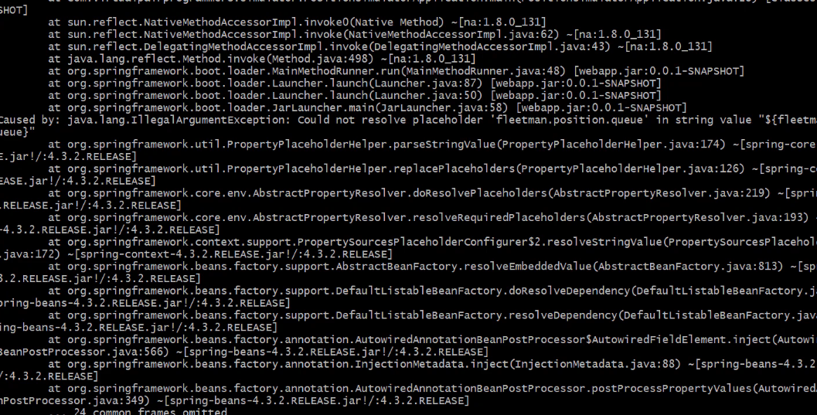
Inspecting Pod Logs
Use kubectl logs <pod-name>
This would show whatever the application is outputting
Can use kubectl logs –f <pod-name> to follow the logs

Slide 34
Persistence
Imagine we have a mongo DB pod running with it’s service etc
And you delete the pod, what happens to the data
It is lost
So when the pod restarts, it looses it’s local drive volumes and the data is lost.

